Slide 1
Randomisation: Misunderstanding, myths and truth.
Stephen Senn
Notes:
I consider a number of misunderstandings of randomisation in clinical trials. Some of them are so persistent and pernicious that they deserve to be qualified as myths. Particularly common in the philosophical literature is the notion that the presence of indefinitely many confounders renders randomisation pointless. I show that this is based on a fallacy of the same sort that would suppose that a sum of infinite terms cannot be bounded. With the aim of a simple game of chances I shall show what one should expect randomisation can do for one and what it cannot. I conclude that randomisation is valuable but should not be used as an excuse for ignoring prognostic information

Slide 2
Acknowledgements
Acknowledgements
Thank you to the ULB for the invitation
This work is partly supported by the European Union’s 7th Framework Programme for research, technological development and demonstration under grant agreement no. 602552. “IDEAL”
Notes:
Contribution to the Brussels Summer School of Mathematics 2015 programme
https://bssm.ulb.ac.be/en/program.html

Slide 3
Plan
I am unsure as to how much you actually know about randomisation in clinical trials, so I am going to give some practical background on this and give you some examples.
There is not much in the way of theory in these but this will give you some feel for the real world of clinical trials
However the practice is important because it is in ignoring the practice that critics have gone astray
The second part will be very different. I am going to cover some of the theory of randomisation

Slide 4
Part I
Basics and practical examples

Slide 5
My excuse for this elementary introduction
Some very clever people have made fools of themselves by telling clinical trialists how they would do things better without understanding the basics

Slide 6
Basics of clinical trials
Clinical trials are comparative
A new treatment is compared to a control in the same trial
Sometimes a standard treatment
Sometimes a placebo
Why?
Because we know results vary strongly from trial to trial
Typically a random choice is made as to which patient gets which treatment
The principle of concurrent control

Slide 7
Basics of clinical trials
Patients are (nearly always) entered sequentially
You treat patients when they ‘present’ at the clinic
They don’t all present at the same time
They are often recruited over several months
Some of them may have finished the trial before others have started
This reality must be faced by all allocation procedures
Randomisation can be regarded as a game between trialist and physician.
Object is to prevent the physician biasing the allocation
Patient recruitment is sequential

Slide 8
Basics of clinical trials
Randomisation is the process of deciding which patient gets which treatment using an element of chance
It can be unrestricted
For example we toss a coin for every new patient
It can be restricted in some way
Randomised blocks
For example in every set of 8 patients, 4 get the new treatment and 4 get the standard but the order is left to chance
What is randomisation?

Slide 9
Basics of clinical trials
The physical basis of blinding involves placebos
Dummy drugs must be available that match each treatment in terms of taste, colour etc.
Every drug manufacturer is required to also make placebos to their own drugs for clinical research and provide them to competitors when asked
The physical basis of blinding

Slide 10
Basics of clinical trials
Drugs do not resemble each other
Therefore in comparative trials we need placebos to each drug
The patient will receive
Either active A and placebo to B
Or placebo to A and active B
This is called the double dummy technique
If the dosing schedules are not the same (e.g. once daily versus twice daily) then placebo occasions have to be organised
This is called double dummy loading
The use of dummies for blinding

Slide 11
Basics of clinical trials
Humans are not good at choosing random sequences
They tend to avoid repetitions
If a particular sequence looks random to you it may also look random to another
The other’s ability to guess may be greater than you think
This means that probability calculations become very speculative
The solution is to randomise
Randomisation is necessary for blinding

Slide 12
Two approaches to allocation
Pre-randomisation
Central-randomisation
Identical looking but numbered packs are sent out to clinics
At random some of the packs are the experimental treatment and some are the control
The investigator gives the next patient the pack with the lowest remaining number
Only at the end of the trial will be it revealed who got what
The investigator enters the patient remotely onto the system giving all patient details
If entry onto the trial is approved the system tells the investigator what pack number to pick up
Only once the patient is entered is the pack number revealed and then it is too late for the investigator to change his mind

Slide 13
Basics of clinical trials
Parallel group
Patients are individually randomised to treatment
for example they either get A or B
Cross-over trial
Patients are randomised to sequences of treatment for the purpose of comparing individual treatments
For example they are randomised to A followed by B or to B followed by A
Cluster randomised trial
Patients are randomised by centre to receive a treatment
For example, either all the patients in that centre receive A or all the patients receive B
Types of clinical trial

Slide 14
What Does Randomisation not Do?
Does not guarantee patients are representative
Does not guarantee balance as regards prognostic factors
Better than many other systems
But only guarantees balance in expectation
For a limited number of factors stratification can be added
Also not possible for all factors

Slide 15
An Example
Most double blind trials are run using the double dummy technique
Patients either receive A and placebo to B or B and placebo to A
But we hardly ever randomise the order in which the two pills are taken
Why not?

Slide 16
Is randomisation fully efficient?
No.
A simple example. We have a parallel group trial currently we have n_{A} patients on A and n_{B} on B. To minimise the variance of the treatment effect we should deliberately allocate the next patient to the treatment with the lower number of patients. (If the trial is currently balanced it makes no difference.)
Proof Assume without loss of generality that n_{A}< n_{B}
If we allocate to group A, the variance of the estimated treatment effect will be proportional to
$\frac{1}{n_{A}+1}+\frac{1}{n_{B}}=\frac{n_{A}+n_{B}+1}{{n_{A}n}_{B}+n_{B}}$ …..(1)
If we allocate to group B, the variance of the estimated treatment effect will be proportional to
$\frac{1}{n_{A}}+\frac{1}{n_{B}+1}=\frac{n_{A}+n_{B}+1}{n_{A}n_{B}+n_{A}}$ …..(2)
However, the numerator of (1) and (2) are identical and the denominators only differ in the last term, +n_{B} (expression 1) or +n_{A} (expression, 2), as the case may be. However since n_{A}<n_{B} we have (1) < (2), therefore we should allocate to group A

Slide 17
But randomisation is often pretty good
“…or by whether their hair is parted on the left or the right, or one could simply permit the subjects to choose their own groups, always ensuring of course that they have not been in- formed of which treatment is to be applied to which group…”
Urbach 1985, p271
Suppose that we assume that the patients choose independently and let θ be the probability that a patient chooses A so (1-θ) is the probability the patients choses B
Randomisation is like knowing θ = 0.5
But every value of θ other than 0.5 is worse

Slide 18
The TARGET study
One of the largest studies ever run in osteoarthritis
18,000 patients
Randomisation took place in two sub-studies of equal size
Lumiracoxib versus ibuprofen
Lumiracoxib versus naproxen
Purpose to investigate cardiovascular and gastric tolerability of lumiracoxib
That is to say side-effects on the heart and the stomach
Sacred cow
(c) Stephen Senn 2012
Notes:
18
This was at the time probably the largest controlled study ever run in osteoarthritis. More that 18,000 patients were entered into the study. Although the condition being treated was osteoarthritis, it was not the primary purpose of the trial to compare the treatments as regards their effects on this condition; it was taken as a given that all three were effective in osteoarthritis. Instead, the treatments were compared as regards their gastric (GI) (Schnitzer, et al.,2004) and cardiovascular (CV) (Farkouh, et al.,2004) side-effects. Lumiracoxib is a so-called COX-II inhibitor. It was expected to have fewer GI side-effects than Naproxen and Ibuprofen, which were established non-steroidal anti-inflammatory drugs (NSAIDs). On the other hand it was considered possible that COX-II inhibitors, including lumiracoxib, might have more CV side-effects.

Slide 19
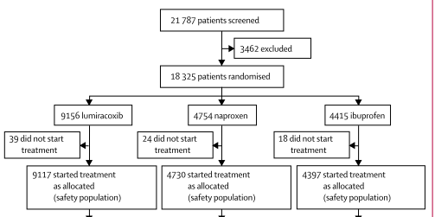
Extract from incorrect CONSORT diagram in the Lancet
Notes:
This appears to be (approximately) a 2:1:1 randomisation. However, an interesting feature of this trial is that patients were not randomised to one of the three treatments. Any given patient was only randomised to one of two, since the trial was run in the form of two sub-studies, the first of which compared lumiracoxib to ibuprofen in a 1:1 randomisation and the second of which compared lumiracoxib to naproxen in a 1:1 randomisation. The reasons for this were to do with administrative convenience but also to make blinding easier. It is a common feature of clinical trials that blind comparison of active treatments can only be achieved by using the so-called double dummy technique. Where active treatment A is compared to active treatment B, patients receive either active A and placebo to B or active B and placebo to A. To effectively blind administration where three treatments were being compared would require a treble dummy technique and this increases the treatment burden on patients and reduces compliance. The net consequence is that as regards comparison of all three treatments, TARGET is what has been referred to as a veiled study (Senn,1995): although patients do not know which treatment they are receiving, they do known that there is a possible treatment they are not receiving.
19

Slide 20
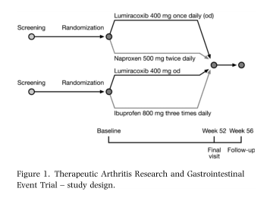
Better non-CONSORT diagram in the design paper: Hawkey et al
Aliment Pharmacol Ther 2004; 20: 51–63
.
Notes:
Hawkey CJ, Farkouh M, Gitton X, Ehrsam E, Huels J, Richardson P. Therapeutic arthritis research and gastrointestinal event trial of lumiracoxib - study design and patient demographics. Aliment Pharmacol Ther 2004; 20: 51-63.
BACKGROUND: Cyclooxygenase-2 selective inhibitors were developed in order to reduce the incidence of life-threatening gastrointestinal ulcer complications compared with non-selective non-steroidal anti-inflammatory drugs. Previous outcomes studies have, variously, lacked power to investigate this endpoint, focused on broader outcomes, or been too small to quantify the influence of aspirin. AIM: To evaluate lumiracoxib, a novel cyclooxygenase-2 selective inhibitor, vs. non-selective non-steroidal anti-inflammatory drugs in an outcomes study of considerably increased size. This paper describes the study's methodology. METHODS AND PATIENTS: The Therapeutic Arthritis Research and Gastrointestinal Event Trial was a randomized, double-blind, 52-week study of lumiracoxib 400 mg once daily (two to four times the recommended dose for osteoarthritis) versus naproxen 500 mg twice daily or ibuprofen 800 mg three-times daily in patients with osteoarthritis. Randomization was stratified for low-dose aspirin use and age (< or = 64, 65-74, > or= 75 years). The study was powered to investigate upper gastrointestinal ulcer complications (primary endpoint) in patients not taking aspirin and in the overall study population; other endpoints included cardiovascular, renal and hepatic measures. CONCLUSIONS: Therapeutic Arthritis Research and Gastrointestinal Event Trial was designed to provide definitive answers concerning the gastrointestinal safety of lumiracoxib, addressing the controversial issues arising from outcomes studies with other cyclooxygenase-2 selective inhibitors.
20

Slide 21
Why this complicated plan?
The treatments have different schedules
Lumiracoxib once daily
Naproxen twice daily
Ibuprofen 3 times daily
To blind this effectively would require very complicated double dummy loading schemes
So centres were recruited into
either lumiracoxib versus naproxen
or lumiracoxib versus ibuprofen

Slide 22
Baseline Demographics
 | Sub-Study 1 |  | Sub Study 2
Demographic Characteristic | Lumiracoxib n = 4376 | Ibuprofen n = 4397 | Lumiracoxib n = 4741 | Naproxen n = 4730
Use of low-dose aspirin | 975 (22.3) | 966 (22.0) | 1195 (25.1) | 1193 (25.2)
History of vascular disease | 393 (9.0) | 340 (7.7) | 588 (12.4) | 559 (11.8)
Cerebro-vascular disease | 69 (1.6) | 65 (1.5) | 108 (2.3) | 107 (2.3)
Dyslipidaemias | 1030 (23.5) | 1025 (23.3) | 799 (16.9) | 809 (17.1)
Nitrate use | 105 (2.4) | 79 (1.8) | 181 (3.8) | 165 (3.5)
Notes:
This show the distribution of selected demographic variables at baseline.

Slide 23
Formal statistical analysis of baseline comparability
Usually I do not recommend doing this
If we have randomised we know that differences must be random
Testing could be used to examine cheating
However here there was randomisation within sub-studies and not between
It thus becomes interesting to see if the tests can detect the difference between the two

Slide 24
Baseline Deviances
 | Model Term
Demographic Characteristic | Sub-study (DF=1) | Treatment given Sub-study (DF=2) | Treatment (DF=2)
Use of low-dose aspirin | 23.57 | 0.13 | 13.40
History of vascular disease | 70.14 | 5.23 | 47.41
Cerebro-vascular disease | 13.54 | 0.14 | 7.75
Dyslipidaemias | 117.98 | 0.17 | 54.72
Nitrate use | 39.83 | 4.62 | 29.17
Notes:
This table gives the results of applying three logistic regression models to each of the five demographic variables listed previously. The table lists the so-called deviance, fitting each of three possible factors: sub-study, treatment given that sub-study is already in the model, and treatment without having sub-study in the model.

Slide 25
Baseline Chi-square P-values
 | Model Term
Demographic Characteristic | Sub-study (DF=1) | Treatment given Sub-study (DF=2) | Treatment (DF=2)
Use of low-dose aspirin | < 0.0001 | 0.94 | 0.0012
History of vascular disease | < 0.0001 | 0.07 | <0.0001
Cerebro-vascular disease | 0.0002 | 0.93 | 0.0208
Dyslipidaemias | <0.0001 | 0.92 | <0.0001
Nitrate use | < 0.0001 | 0.10 | <0.0001
Notes:
The deviances should have (approximately) a chi-square distribution under the null hypothesis that there is no systematic difference between groups associated with the classification in question for the variable in question. For sub-study the degrees of freedom should be 1 and for the other two they should be 2. The table above gives the P-values associated with the various significance tests.
For every demographic variable, it will be seen that there is a significant ‘effect’ of sub-study, a non-significant ‘effect’ of treatment if sub-study is in the model and a significant ‘effect’ of treatment if sub-study is not in the model.
In other words, the process by which patients were allocated to treatment is such that sub-study must be in the model in order to permit a valid comparison of the outcomes of this trial between treatments, since there are already important differences between treatment groups at baseline.

Slide 26
To sum up
There are important differences between the sub-studies at the outset and which would be extremely unlikely to occur by chance
On the other hand the sort of difference that we see within sub-studies at baseline is the sort that could arise very easily by chance
So it seems at least that not randomising can be very dangerous
In this trial provided we compare treatments within sub-studies there is no problem

Slide 27
Outcome Variables All four groups
 | Sub-Study 1 |  | Sub Study 2
Outcome Variables | Lumiracoxib n = 4376 | Ibuprofen n = 4397 | Lumiracoxib n = 4741 | Naproxen n = 4730
Total of discontinuations | 1751 (40.01) | 1941 (44.14) | 1719 (36.26) | 1790 (37.84)
CV events | 33 (0.75) | 32 (0.73) | 52 (1.10) | 43 (0.91)
At least one AE | 699 (15.97) | 789 (17.94) | 710 (14.98) | 846 (17.89)
Any GI | 1855 (42.39) | 1851 ( 42.10) | 1785 (37.65) | 1988 (21.87)
Dyspepsia | 1230 (28.11) | 1205 (27.41) | 1037 (21.87) | 1119 (23.66)
Notes:
Of course these variables would quite plausibly differ between treatment groups. However had the patients been randomised between and within sub-study
One would not expect those patients given lumiracoxib to differ between sub-studies.

Slide 28
Outcome Variables Lumiracoxib only
 | Sub-Study 1 |  | Sub Study 2
Outcome Variables | Lumiracoxib n = 4376 |  | Lumiracoxib n = 4741
Total of discontinuations | 1751 (40.01) |  | 1719 (36.26)
CV events | 33 (0.75) |  | 52 (1.10)
At least one AE | 699 (15.97) |  | 710 (14.98)
Any GI | 1855 (42.39) |  | 1785 (37.65)
Dyspepsia | 1230 (28.11) |  | 1037 (21.87)
Notes:
Now we just compare the lumiracoxib patients

Slide 29
Deviances and P-Values Lumiracoxib only fitting Sub-study
 | Statistic
Outcome Variables | Deviance | P-Value
Total of discontinuations | 13.61 | 0.0002
CV events | 2.92 | 0.09
At least one AE | 1.73 | 0.19
Any GI | 21.31 | <0.0001
Dyspepsia | 47.34 | < 0.0001
Notes:
Now we just compare the lumiracoxib patients. Note that for some outcome variables the sub-study effect is clearly significant and for others it is not. However, all deviances are greater than 1.

Slide 30
Is it a between-centre difference?
TARGET had 18,224 patients in 849 centres
Centre size varied from 12 to 167 patients with an average of 22
However the deviance at outcome for sub-study amongst lumiracoxib for discontinuation is 37.4 and for dyspepsia is 16.8 and these are not easily explained as being due to random differences between centres

Slide 31
A Simple Model
An unrealistic balanced trial
$n$ patients per arm, $c$ centres in total with $p$ patients per centre
$$2n=pc, n=\frac{pc}{2}$$
Between-centres variance is γ² within-centre variance is σ².
Design | Variance of Treatment Contrast
Completely randomised | 4$\frac{\left(γ^{2}+σ^{2}\right) }{cp}$
Randomised blocks (centre blocks) | 4$\frac{σ^{2}}{cp}$
Cluster randomised | 4$\frac{\left(γ^{2}+\frac{σ^{2}}{p}\right) }{c}$
When using external controls we have at least the variability of a cluster randomised trial

Slide 32
Lessons from TARGET
If you want to use historical controls you will have to work very hard
You need at least two components of variation in your model
Between centre
Between trial
And possibly a third
Between eras
What seems like a lot of information may not be much
Concurrent control and randomisation seems to work well

Slide 33
Part 2
Some theory

Slide 34
Game of Chance
Two dice are rolled
Red die
Black die
You have to call correctly the probability of a total score of 10
Three variants
Game 1 You call the probability and the dice are rolled together
Game 2 the red die is rolled first, you are shown the score and then must call the probability
Game 3 the red die is rolled first, you are not shown the score and then must call the probability

Slide 35
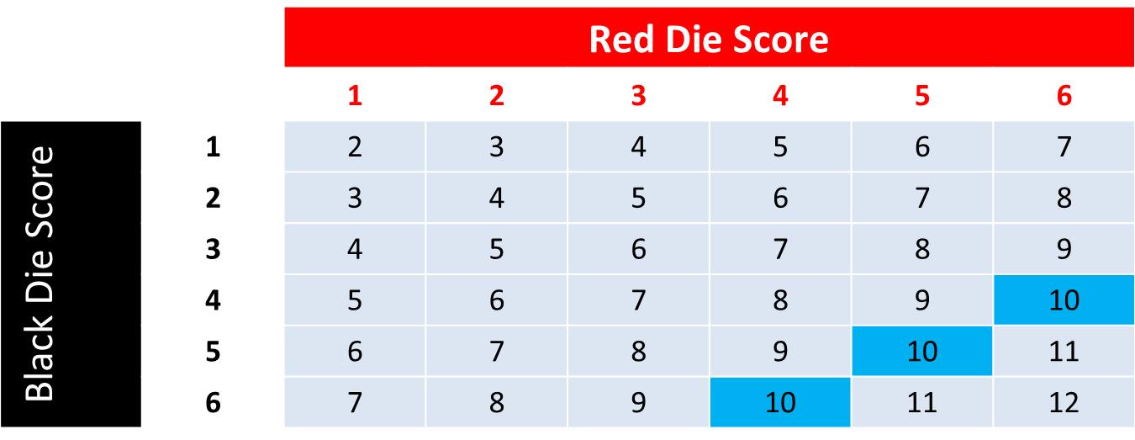
Total Score when Rolling Two Dice
Variant 1. Three of 36 equally likely results give a 10. The probability is 3/36=1/12.

Slide 36
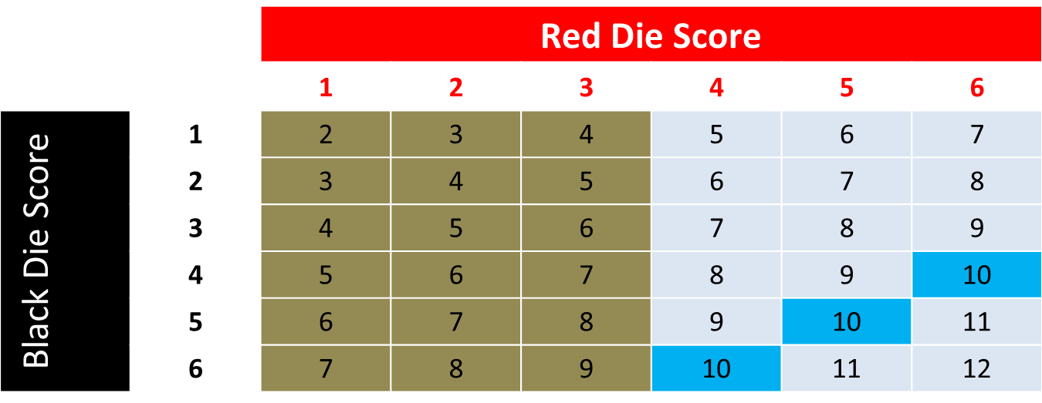
Total Score when Rolling Two Dice
Variant 2: If the red die score is 1,2 or 3, the probability of a total of10 is 0. If the red die score is 4,5 or 6, the probability of a total of10 is 1/6.
Variant 3: The probability = (½ x 0) + (½ x 1/6) = 1/12

Slide 37
The morals
Dice games
Clinical Trials
You can’t treat game 2 like game 1
You must condition on the information received
You must use the actual data from the red die
You can treat game 3 like game 1
You can use the distribution in probability that the red die has
You can’t ignore an observed prognostic covariate just because you randomised
That would be to treat game 2 like game 1
You can ignore an unobserved covariate precisely because you did randomise
You are entitled to treat game 3 like game 1

Slide 38
The error
The error is to assume that because you can’t use randomisation as a justification for ignoring information it is useless
It is useful for what you don’t see
Knowing that the two-dice game is fair is important even though the average probability is not relevant to game two
Average probabilities are important for calibrating your inferences
Your conditional probabilities must be coherent with your marginal ones
See the relationship between the games

Slide 39
A Red Herring
“Even if there is only a small probability that an individual factor is un- balanced, given that there are indeﬁnitely many possible confounding factors, then it would seem to follow that the probability that there is some factor on which the two groups are unbalanced (when remember randomly constructed) might for all anyone knows be high. “ Worrall, 2002
One sometimes hears that the fact that there are indefinitely many covariates means that randomisation is useless
This is quite wrong
It is based on a misunderstanding that variant 3 of our game should not be analysed like variant 1
I showed you that it should

Slide 40
You are not free to imagine anything at all
Imagine that you are in control of all the thousands and thousands of covariates that patients will have
You are now going to allocate the covariates and their effects to patients
As in a simulation
If you respect the actual variation in human health that there can be you will find that the net total effect of these covariates is bounded
$$Y=β_{0}+τZ+β_{1}X_{1}+…β_{k}X_{k}+…$$
Where Z is a treatment indicator, τ si the treatment effect, and the X are covariates. You are not free to arbitrarily assume any values you like for the Xs and the $βs$ because the variance of Y must be respected.

Slide 41
What happens if you don’t pay attention
Simulation of the linear predictor as the number of covariates increases from 1 to 5
However, the variance of each covariate is the same and the coefficient is the same and the covariates are assumed orthogonal
We can see that the variance of the predictor keeps on increasing
The values soon become impossible
The total contribution that the covariates can make is bounded
Notes:
"Worrall's fallacy"
"To illustrate the consequences of assuming that indefinitely
many covariates can be ruining the argument for randomisation"
"Set parameters"
SCALAR[IPRINT=EXTRA] k,n;VALUE=5,2000;Extra='number of covariates','Number of patients'
SCALAR mean,SD;VALUE=3.0,0.3
SCALAR beta;VALUE=1
POINTER[NVALUES=k]Covariate,Pred,LPred
SCALAR variance
CALCULATE variance=SD**2
"Simulate valuies of covariates"
GRANDOM [NVALUES=n;MEAN=mean;VARIANCE=variance;DISTRIBUTION=NORMAL]Covariate[]
"Calculate linear predictor as a function of first covariate"
CALCULATE LPred[1]=mean+beta*(Covariate[1]-mean)
"Now calculate value of predictor as function of further covariates"
SCALAR k1,J1,I1
CALCULATE k1=k-1
FOR[NTIMES=k1;INDEX=I]
CALCULATE I1=I+1
FOR [NTIMES=I;INDEX=J]
CALCULATE J1=J+1
CALCULATE LPred[I1]=LPred[I]+beta*(Covariate[J1]-mean)
ENDFOR
ENDFOR
"Summarise results"
DESCRIBE [SELECTION=nobs,nmv,mean,median,min,max,q1,q3,sd] LPred[]
"Begin calculation of empirical density distributions"
POINTER[NVALUES=k]grid,density
KERNELDENSITY [PRINT=integral,summary; METHOD=sj; NGRIDEXPONENT2=11; PROPORTION=!(0.025,\
0.25,0.5,0.75,0.975); WINDOW=1] SAMPLE=LPred[]; GRID=grid[]; DENSITY=density[]
"Plot results"
TEXT [NVALUES=5] Label
READ[PRINT=*] Label
'black = 1' 'red = 2' 'blue = 3' 'brown = 4' 'orange = 5' :
PEN [RESET=yes] 1,2,3,4,5; METHOD=monotonic; SYMBOL=0; THICKNESS=2;\
COLOUR='black','red','blue','brown','orange'
XAXIS [RESET=yes] WINDOW=1; TITLE='Linear predictor'
YAXIS [RESET=yes] WINDOW=1; TITLE='Density'
DGRAPH [WINDOW=1; KEYWINDOW=2;TITLE='Distribution for linear predictor as a function of 1 to 5 covariates'] \
Y=density[]; X=grid[]; PEN=1,2,3,4,5;DESCRIPTION=Label$[1...5]

Slide 42
In fact this is pointless
Look at the equation again
$$Y=β_{0}+τZ+β_{1}X_{1}+…β_{k}X_{k}+…$$
We have to take care how we choose the parameters of the $X_{1}, ..X_{k} and β_{1}…β_{k}$ and what we have to guide us are the possible values of Y. But suppose we re-write the equation
$$Y=Y^{∗}+τZ$$
Where
$$Y^{∗}=β_{0}+β_{1}X_{1}+…β_{k}X_{k}+…$$
Now there is only one unknown, $Y^{∗}$ not indefinitely many, and this is all that we need to consider

Slide 43
The importance of ratios
So from one point of view there is only one covariate that matters
potential outcome
If you know this, all other covariates are irrelevant
And just as this can vary between groups in can vary within
The t-statistic is based on the ratio of differences between to variation within
Randomisation guarantees (to a good approximation) the unconditional behaviour of this ratio and that is all that matters for what you can’t see (game 3)
An example follows

Slide 44
Hills and Armitage 1979
Trial of enuresis
Patients randomised to one of two sequences
Active treatment in period 1 followed by placebo in period 2
Placebo in period 1 followed by active treatment in period 2
Treatment periods were 14 days long
Number of dry nights measured

Slide 45
Important points to note
Because every patient acts as his own control all patient level covariates (of which there could be thousands and thousands) are perfectly balanced
Differences in these covariates can have no effect on the difference between results under treatment and the results under placebo
However, period level covariates (changes within the lives of patients) could have an effect
My normal practice is to fit a period effect as well as patients effects, however, I shall omit doing so to simplify

Slide 46
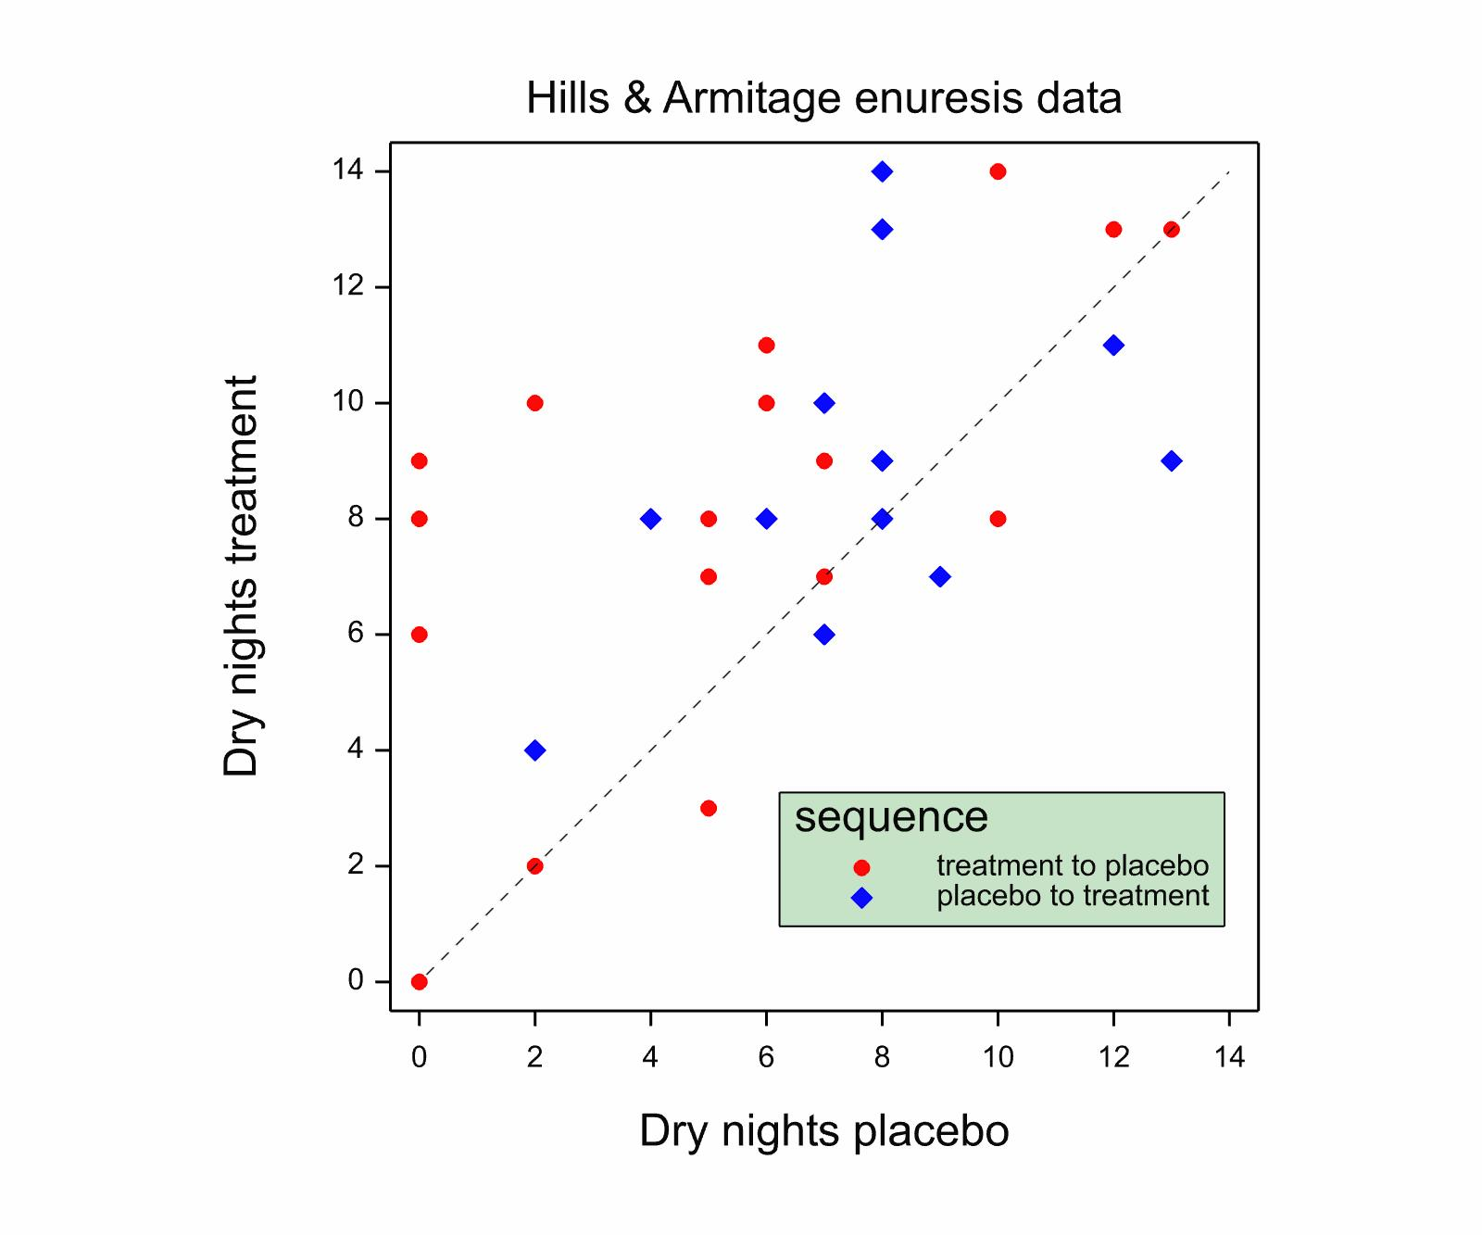
Cross-over trial in Enuresis
Two treatment periods of 14 days each
1. Hills, M, Armitage, P. The two-period cross-over clinical trial, British Journal of Clinical Pharmacology 1979; 8: 7-20.
Notes:
46

Slide 47
Two Parametric Approaches
Not fitting patient effect
Estimate s.e. t(56) t pr.
2.172 0.964 2.25 0.0282
Fitting patient effect
Estimate s.e. t(28) t pr
.
2.172 0.616 3.53 0.00147
Note that ignoring the patient effect, the P-value is less impressive and the standard error is larger
The method posts higher uncertainty because unlike the within-patient analysis it make no assumption that the patient level covariates are balanced.
Of course, in this case, since we know the patient level covariates are balanced, this analysis is invalid.

Slide 48
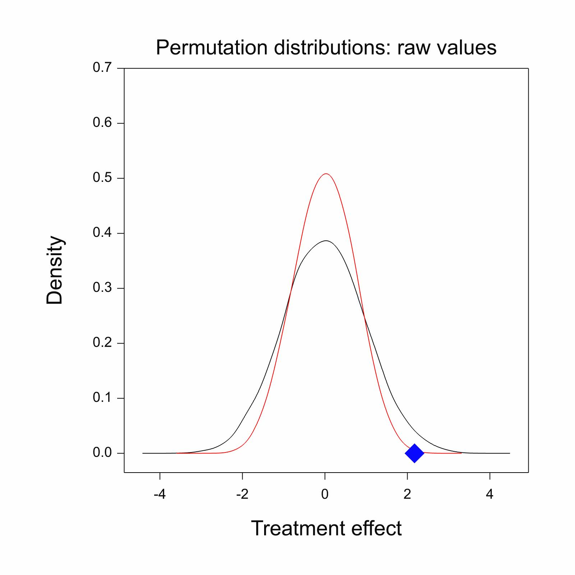
Blue diamond shows treatment effect whether we condition on patient or not as a factor.
It is identical because the trial is balanced by patient.
However the permutation distribution is quite different and our inferences are different whether we condition (red) or not (black) and clearly balancing the randomisation by patient and not conditioning the analysis by patient is wrong
Notes:
10000 simulations were carried out in each case and , having randomly permuted the treatment labels, the treatment effect calculated. The actual value is indicated by a blue diamond. The curves give the estimated distribution using a nonparametric distribution.

Slide 49
The two permutation* distributions summarised
Summary statistics for Permuted difference no blocking
Number of observations = 10000
Mean = -0.00319
Median = -0.0345
Minimum = -3.621
Maximum = 3.690
Lower quartile = -0.655
Upper quartile = 0.655
Standard deviation = 0.993
P-value for observed difference 0.0344
(Parametric P-value 0.0282)
*Strictly speaking, these are randomisation distributions
Summary statistics for Permuted difference blocking
Number of observations = 10000
Mean = -0.00339
Median = 0.0345
Minimum = -2.793
Maximum = 2.517
Lower quartile = -0.517
Upper quartile = 0.517
P-value for observed difference 0.001
(Parametric P-value 0.00147)
Notes:
* Strictly these are randomisation distributions

Slide 50
What happens if you balance but don’t condition?
That is to say, permute values respecting the fact that they come from a cross-over but analysing them as if they came from a parallel group trial
Approach | Variance of estimated treatment effect over all randomisations* | Mean of variance of estimated treatment effect over all randomisations*
Completely randomised Analysed as such | 0.987 | 0.996
Randomised within-patient Analysed as such | 0.534 | 0.529
Randomised within-patient Analysed as completely randomised | 0.534 | 1.005
*Based on 10000 random permutations
Notes:
NB not only is the posted variance for the hybrid approach (approach 3) not correct it actually increases compared to the completely randomised design!

Slide 51
In terms of t-statistics
Approach | Observed variance of t-statistic over all randomisations* | Predicted theoretical variance
Completely randomised Analysed as such | 1.027 | 1.037
Randomised within-patient Analysed as such | 1.085 | 1.077
Randomised within-patient Analysed as completely randomised | 0.534 | 1.037@
*Based on 10000 random permutations @ Using the common falsely assumed theory

Slide 52
The Shocking Truth
The validity of conventional analysis of randomised trials does not depend on covariate balance
It is valid because they are not perfectly balanced
If they were balanced the standard analysis would be wrong

Slide 53
Typical nonsense encountered in the medical press
‘The central telephone randomisation system used a minimisation algorithm to balance the treatment groups with respect to eligibility criteria and other major prognostic factors.’ (p24)
‘All comparisons involved logrank analyses of the first occurrence of particular events during the scheduled treatment period after randomisation among all those allocated the vitamins versus all those allocated matching placebo capsules (ie, they were “intention-to treat” analyses).’ (p24)
1. (2002) MRC/BHF Heart Protection Study of cholesterol lowering with simvastatin in 20,536 high-risk individuals: a randomised placebo-controlled trial. Lancet 360:7-22

Slide 54
My Philosophy of Clinical Trials
Your (reasonable) beliefs dictate the model
You should try measure what you think is important
You should try fit what you have measured
Caveat : random regressors and the Gauss-Markov theorem
If you can balance what is important so much the better
But fitting is more important than balancing
Randomisation deals with unmeasured covariates
You can use the distribution in probability of unmeasured covariates
For measured covariates you must use the actual observed distribution
Claiming to do ‘conservative inference’ is just a convenient way of hiding bad practice
Who thinks that analysing a matched pairs t as a two sample t is acceptable?

Slide 55
What’s out and What’s in Out In
Log-rank test
T-test on change scores
Chi-square tests on 2 x 2 tables
Responder analysis and dichotomies
Balancing as an excuse for not conditioning
Proportional hazards
Analysis of covariance fitting baseline
Logistic regression fitting covariates
Analysis of original values
Modelling as a guide for designs
Notes:
Responder analysis is an appalling crime that is responsible for killing thousands of patients every year and wasting billions of dollars

Slide 56
Unresolved Issue
In principle you should never be worse off by having more information
The ordinary least squares approach has two potential losses in fitting covariates
Loss of orthogonality
Losses of degrees of freedom
This means that eventually we lose by fitting more covariates

Slide 57
The Problem
However, this seems to imply that in making inferences for randomised clinical trials we must condition on everything we observe
All covariates must be in the model
What is the effect on efficiency?
Could it mean that more information is worse than less?
Notes:
57

Slide 58
A Quote from Jack Good
The use of random sampling is a device for obtaining apparently precise objectivity but this precise objectivity is attainable, as always, only at the price of throwing away some information (by using a Statistician’s Stooge who knows the random numbers but does not disclose them)…
…But the use of sampling without randomization involves the pure Bayesian in such difficult judgments that, at least if he is at all Doogian, he might decide by Type II rationality, to use random sampling to save time.
58
Notes:
58
P34

Slide 59
Resolution?
In theory we can do better than ordinary least squares by having random effect models
Gauss-Markov theorem does not apply to stochastic regressors
However there are severe practical difficulties
Possible Bayesian resolution in theory
A pragmatic compromise of a limited number of prognostic factors may be reasonable
This is exactly what ICHE9 suggests
Awareness of the issues seems to be much greater amongst drug regulators than amongst journal editors

Slide 60
To sum up
Randomisation makes a valuable contribution to handling unobserved variables
Randomisation does not guarantee balance of unobserved variables
This balance is not needed
If it applied conventional analyses would be invalid
Randomisation is not an excuse for ignoring prognostic covariates
Some technical challenges remain but these are challenges of modelling not randomisation per se

Slide 61
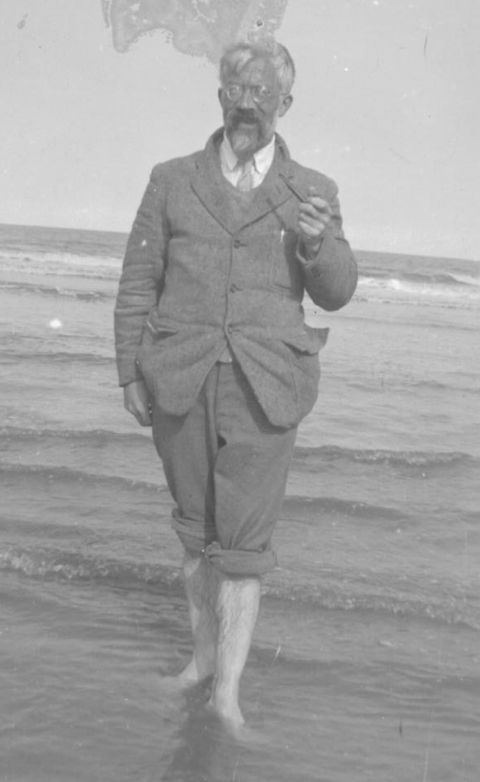
Finally
I leave you with
this thought
Statisticians are always tossing coins but do not own many
RA Fisher at Mablethorpe

